Slide 1
Corrective Action Review for Calibration Meeting (March, 2014)
V 1.0

Slide 2
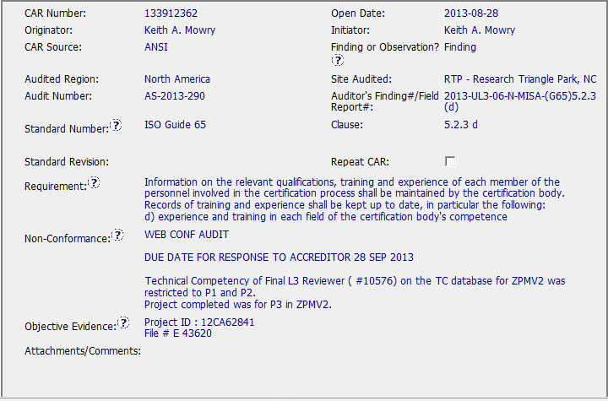
CAR 133912362
Issue: Lack of Competency qualification

Slide 3
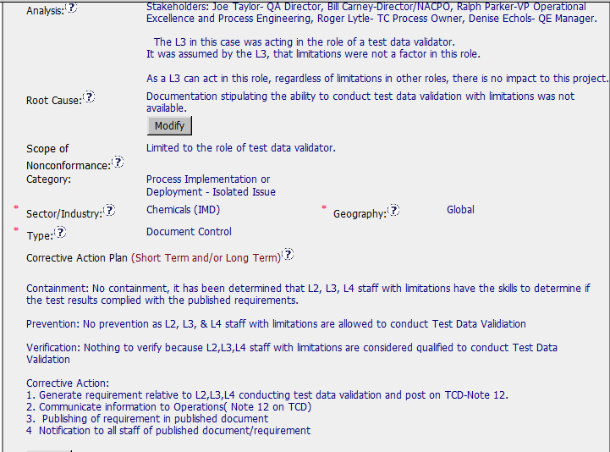
CAR 133912362

Slide 4
CAR 133912362- Questions:
Who determined that personnel had qualification to do Test Data Validation?
Why is root cause “document control”? Maybe “Tech Comp Qualification” instead?
Why not verified immediately after closing due to nature of corrective action?
Lack of verification milestone should be addressed, as was containment.
Overall appropriate and timely action taken. Moved along nicely by admin.

